Slide 1
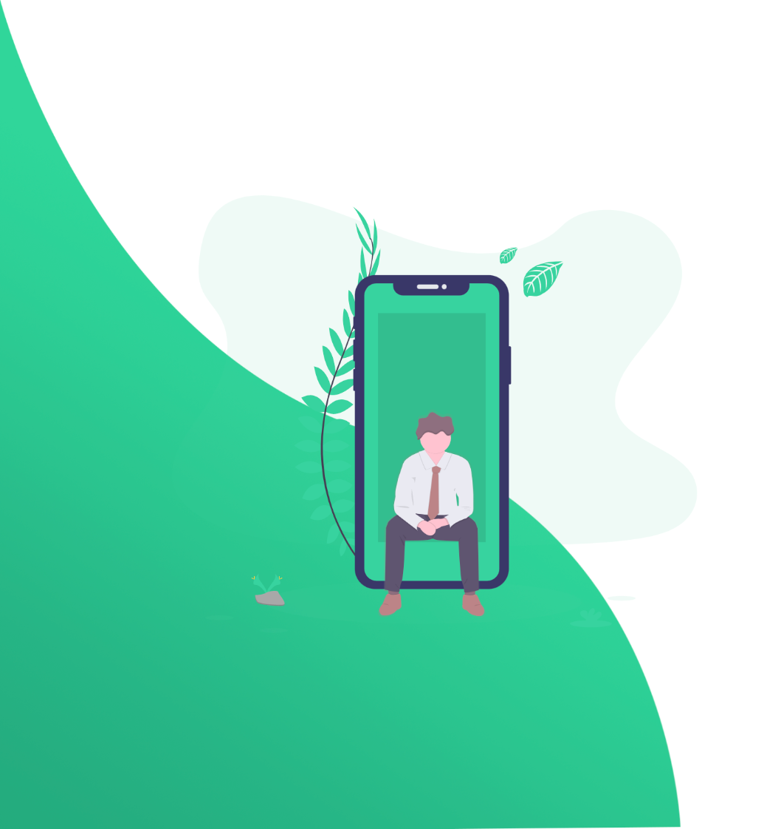
Czech Technical University, 2022/2023 Winter Semester - Project for BIE-SP2.2
Household Web
User Guide
By HyeonJi Kang, Oleksandr Yakunin, Victor Petukhov, Yaroslav Borovyk
FOLLOW & CLICK WITH ME!

Slide 2
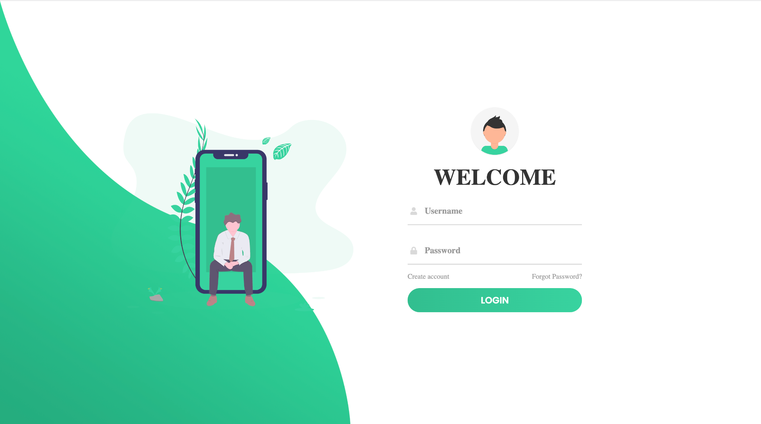
Let’s go to Our Website

Slide 3
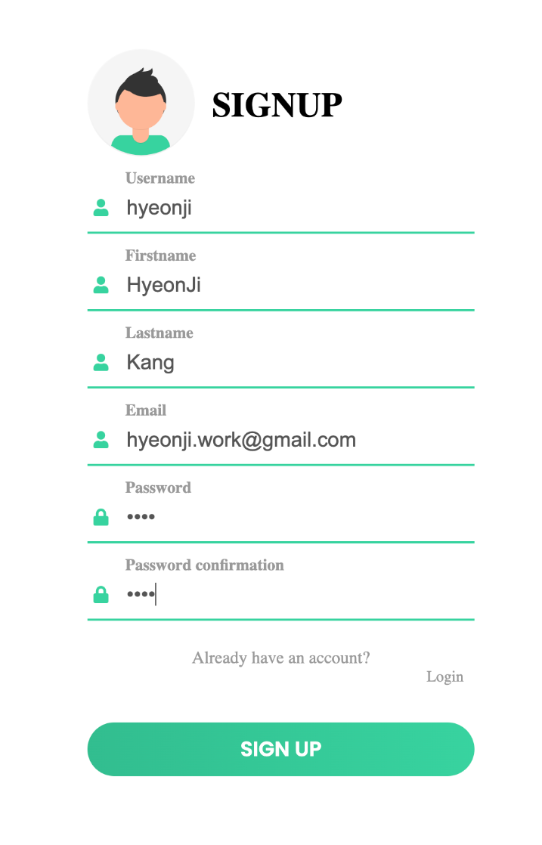
How to sign up
Username can be anything but UNIQUE.
It will be used whenever you login and inside of the web.
Email must be a valid one and UNIQUE.
It will be used for an activation and password recovery. *One email address can be used for only one account!
Once you are done with every field,
Click on “SIGN UP” a verification link will be sent to your email!
*You must login via this link first to activate your account!

Slide 4
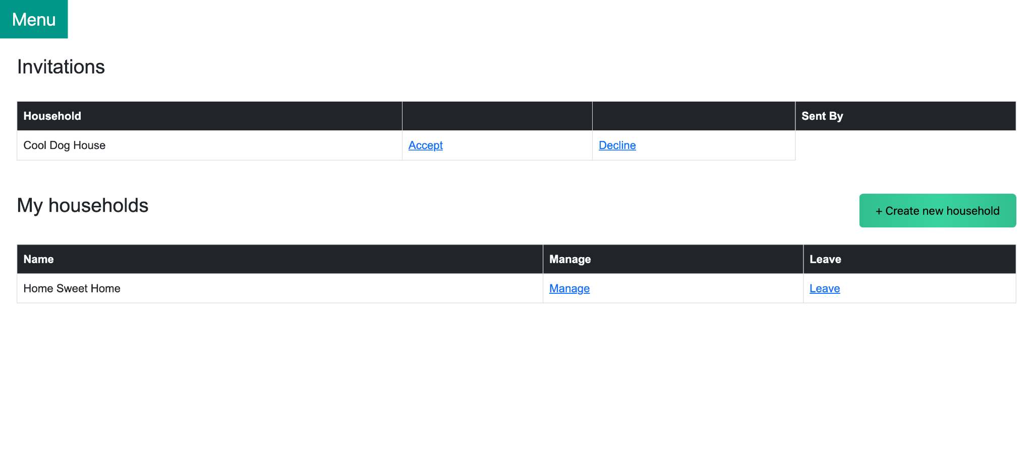
Main Page
When you are successfully logged in!
👈
Invitations to a household from other users
👈
List of the households you are belonging to

Slide 5
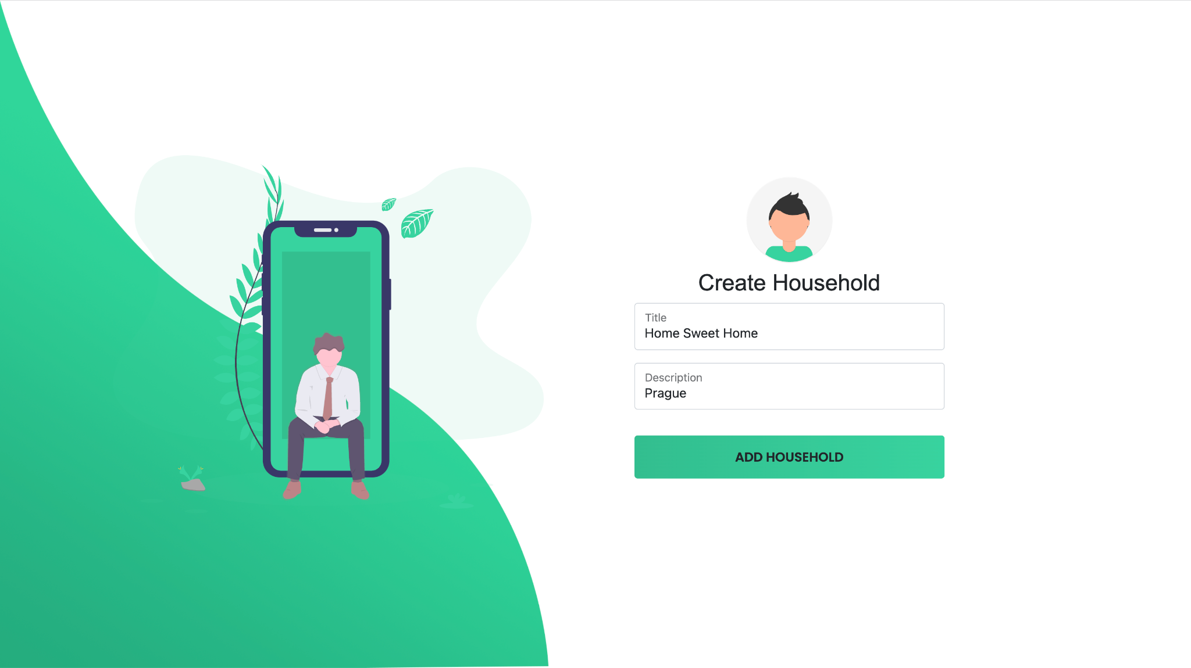
Household
Creating a new household
Create your own household with
any title you prefer & optional description
*They can be modified later in the household manage page

Slide 6
Household
Managing a household
👈
You can leave from the household by clicking this button

Slide 7
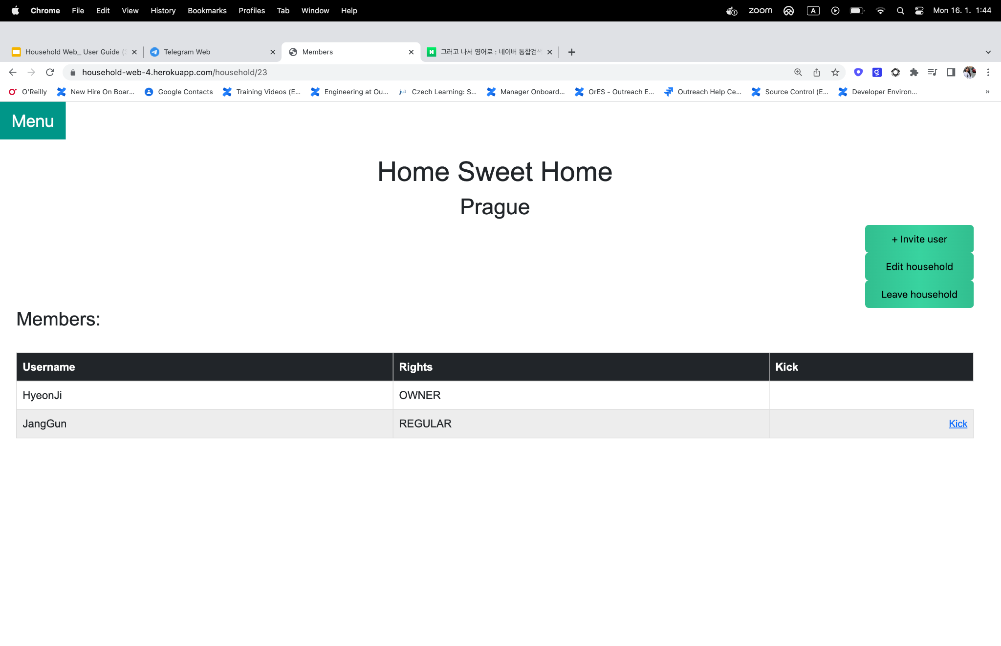
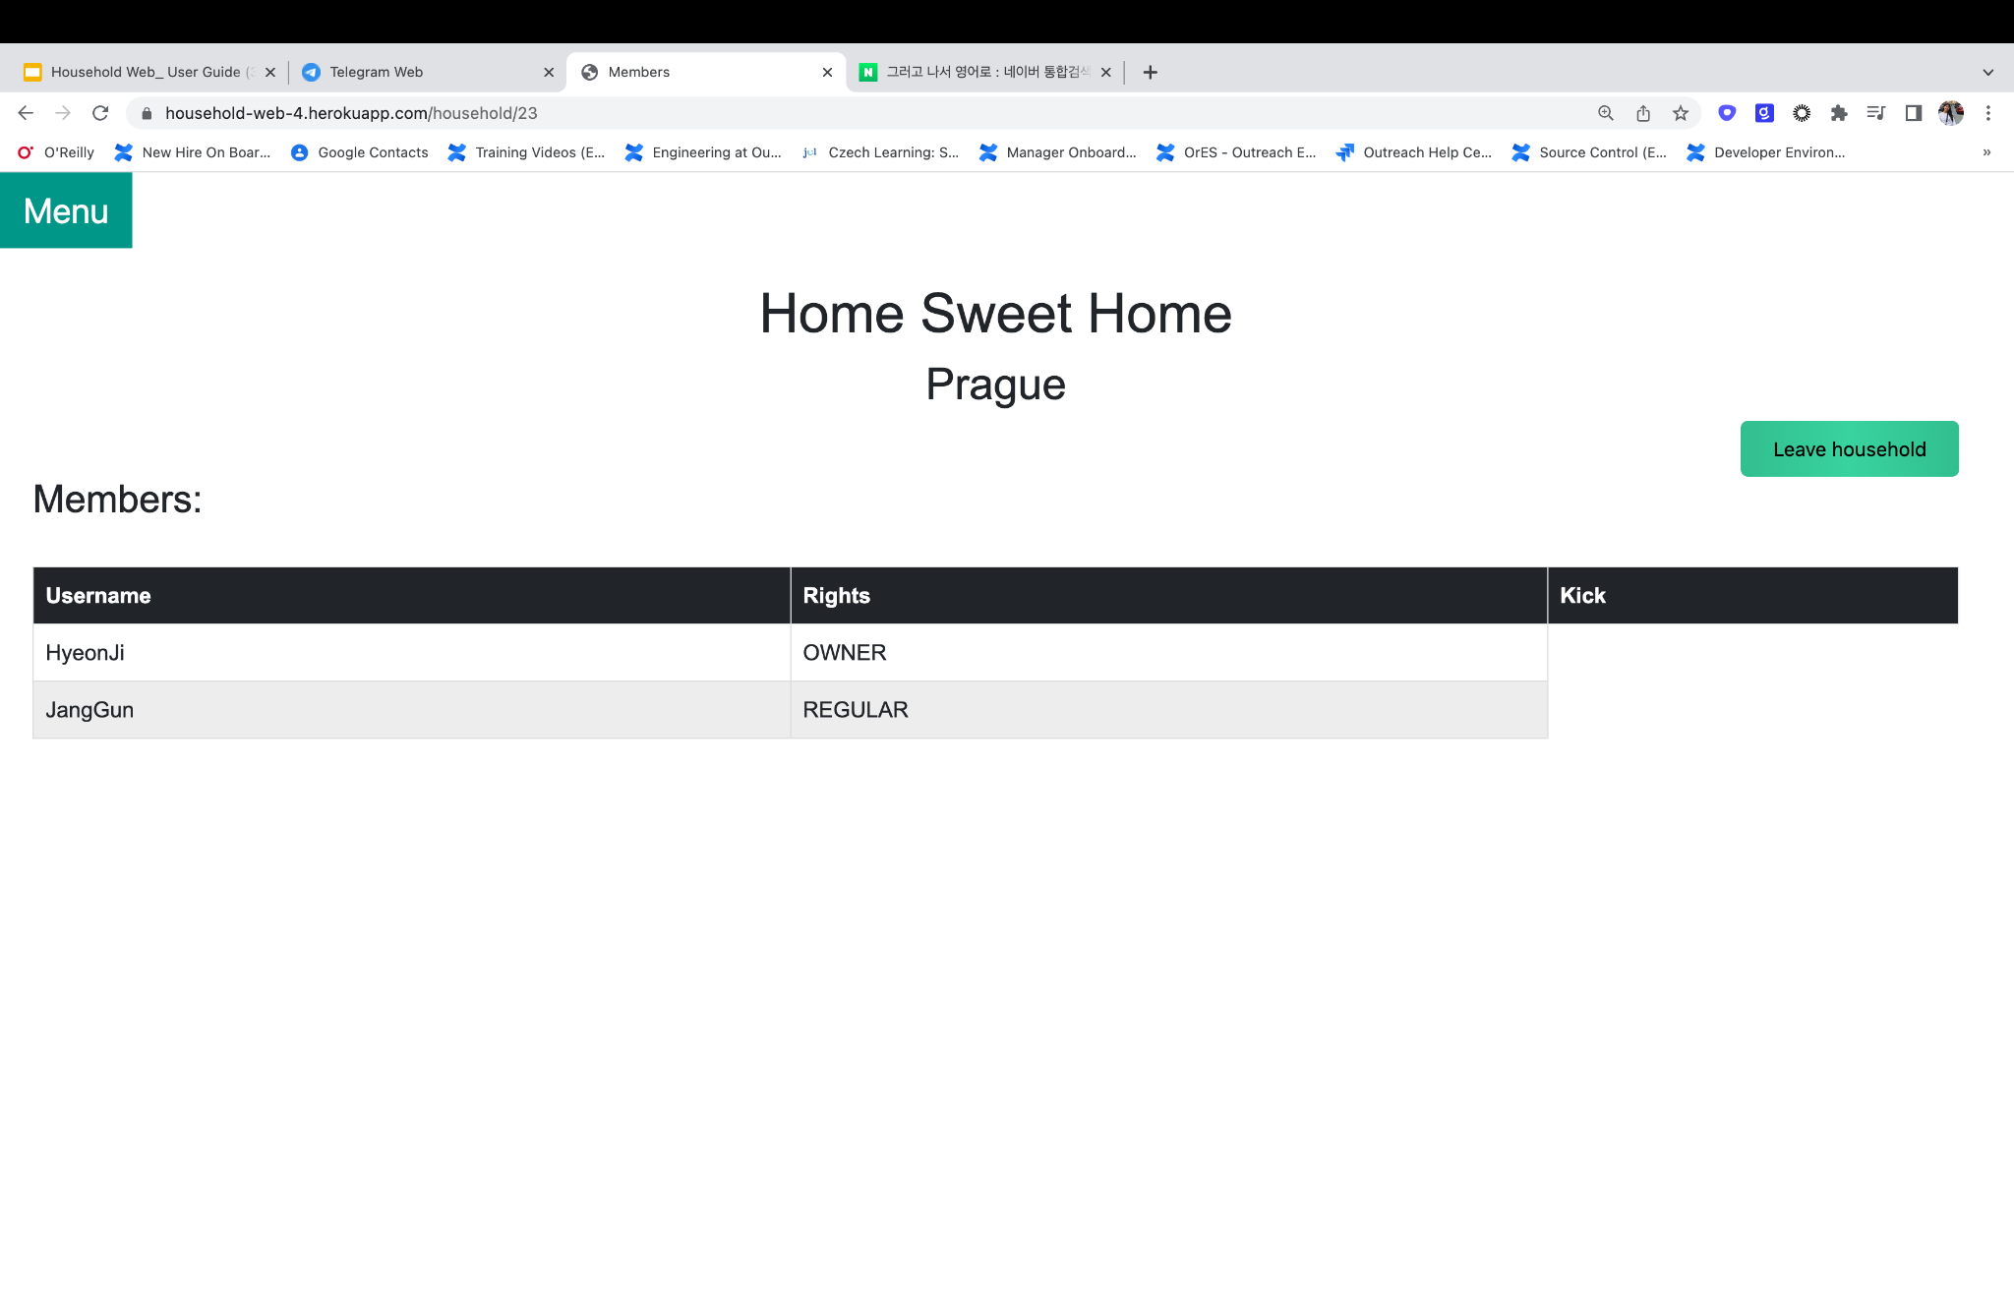
Household
Managing a household
👈When you are the Owner, you can
invite a user
edit the household (title & description)
kick out other members from the household
leave from the household
👈When you are a Regular member, you can
leave from the household

Slide 8
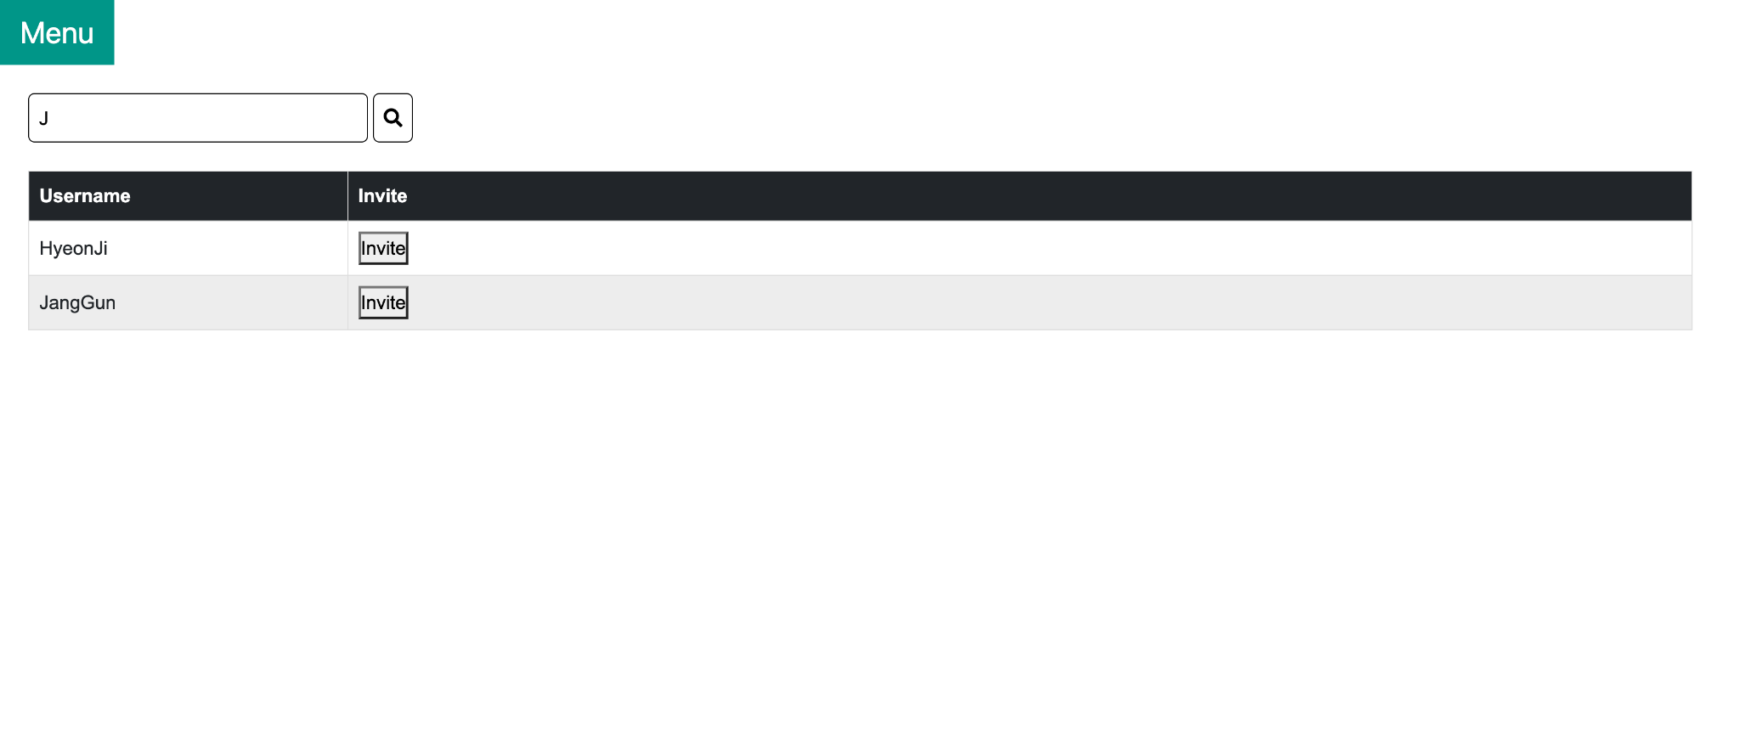
Household
Inviting a user
👈 Case-sensitive substring search
Invite a user by clicking on “Invite” button!
The invited users will accept/decline your invitation on their main page!

Slide 9
Menu Bar
*There is a hidden Menu bar under Household Manage page!

Slide 10
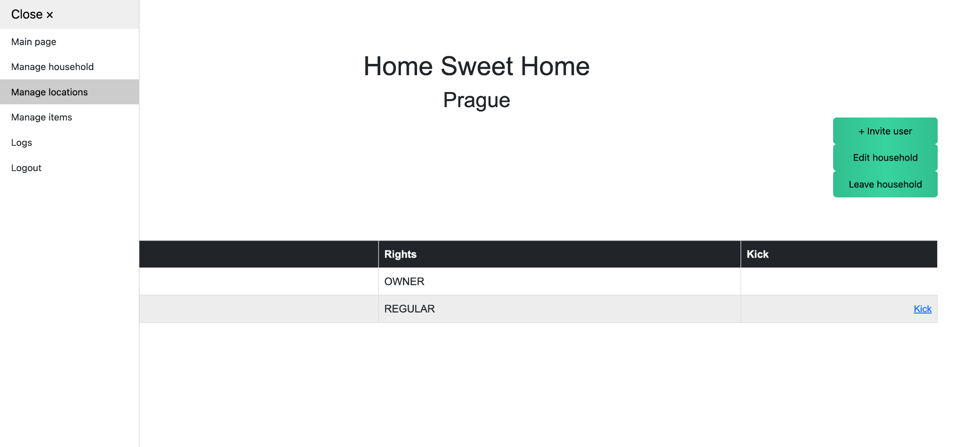
Menu Bar

Slide 11
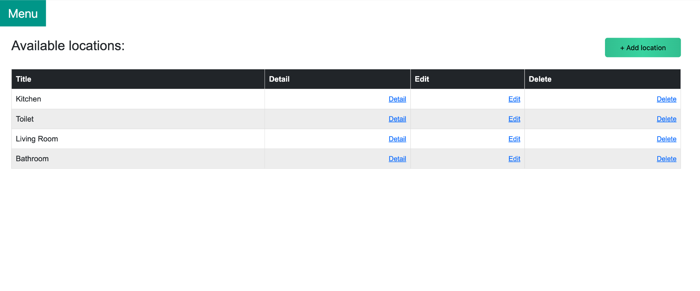
Location
Creating a Location
👈
You can create a new item here (Title & optional Description)
👆You can change Title and Description

Slide 12
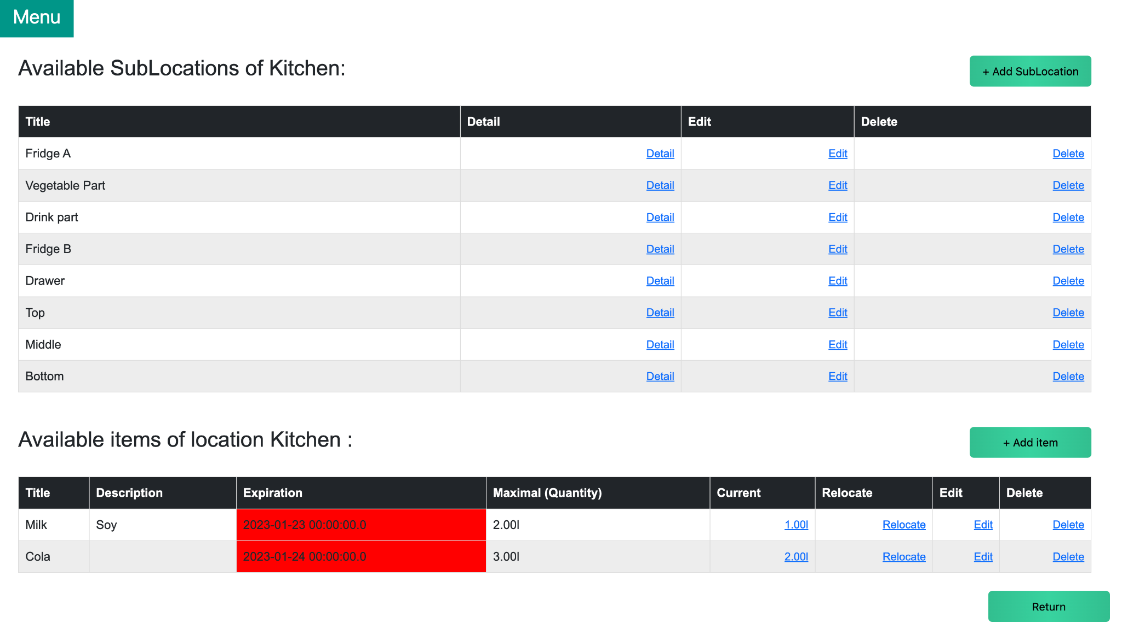
Location
Creating a Sub-Location and Item
👈
You can create many sub-locations under one location
You can also create sub-locations of sublocations ex) Kitchen/ Fridge A/ Drink Part Kitchen/ Drawer/ Top
👈
Go back to its super-location

Slide 13
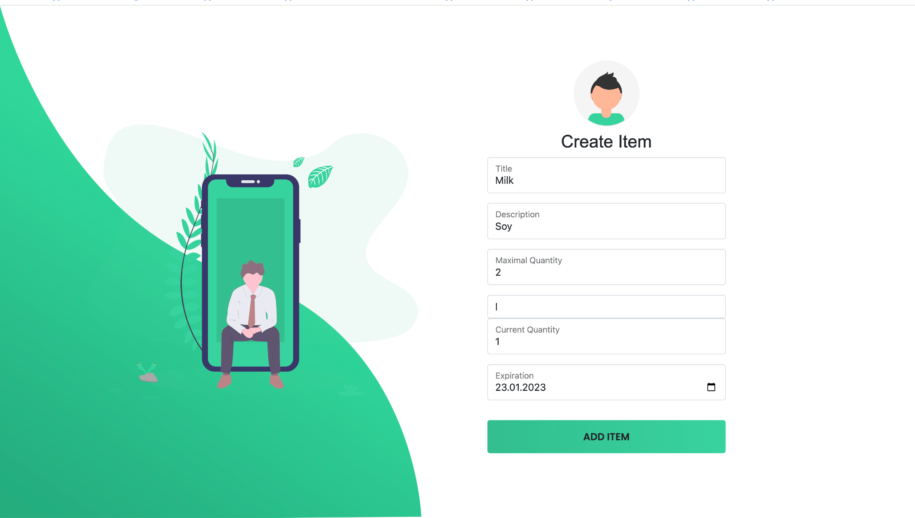
Item
Creating a new item
*Maximum Quantity must be bigger or equal to Current Quantity
*Units are mandatory (Kg, L, Pcs, etc)
👈
*Expiration Date cannot be earlier than TODAY
Expiration Date is not mandatory for some products without it

Slide 14
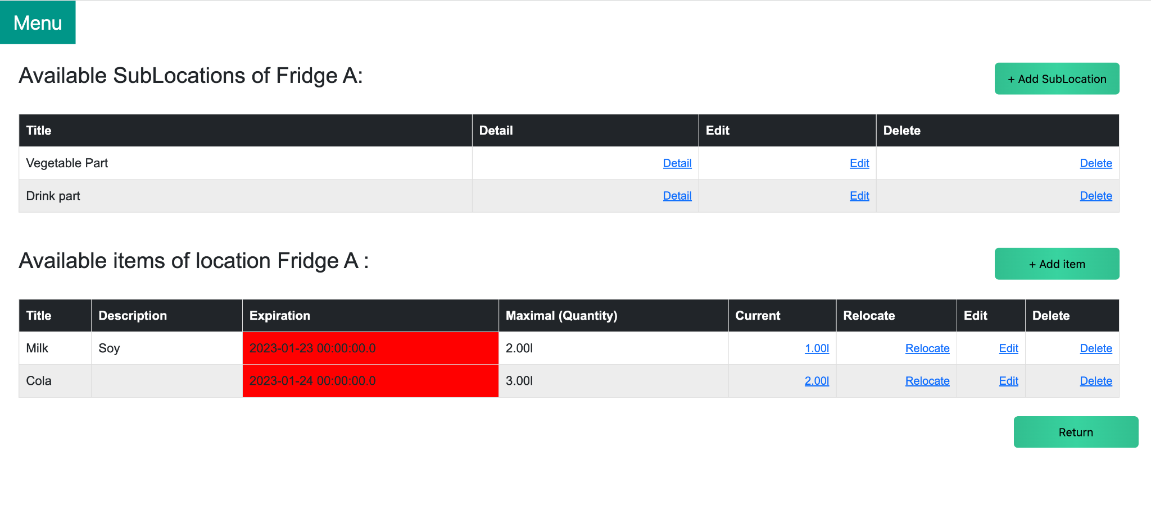
Item
Managing items under a location
👈
You can always
increase/decrease amount under Current. relocate items to ANY location under Relocate. edit the whole definition under Edit

Slide 15
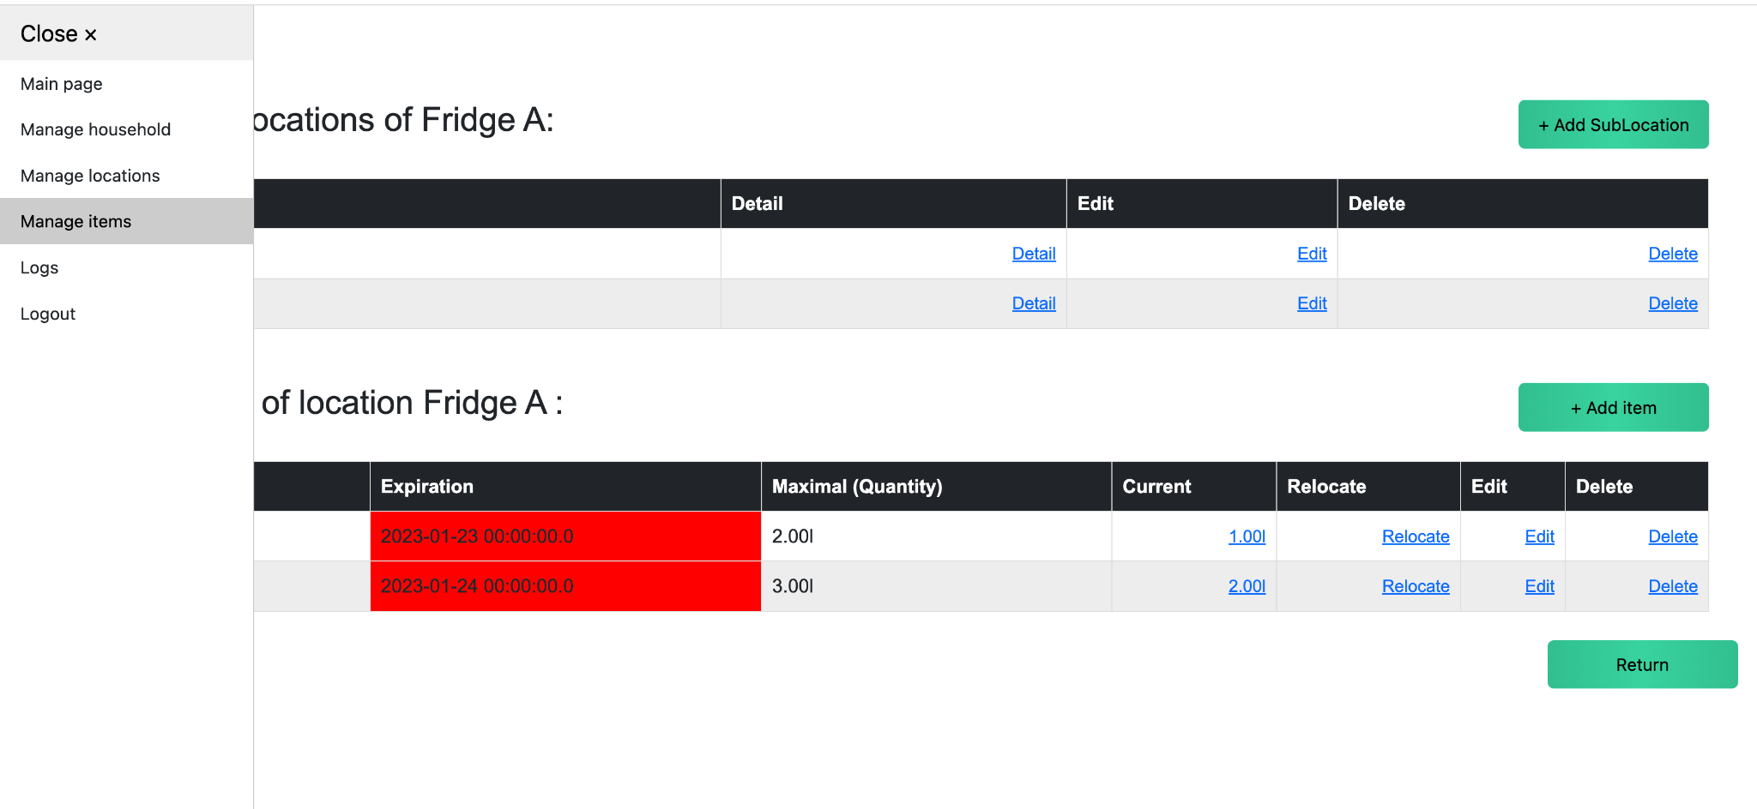
Item
Managing ALL Items

Slide 16
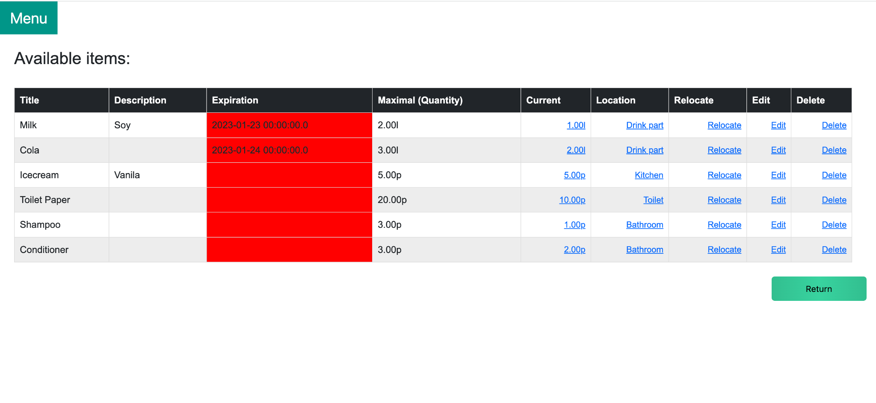
Item
Managing ALL Items
You can see and manage ALL the items in every location here.

Slide 17
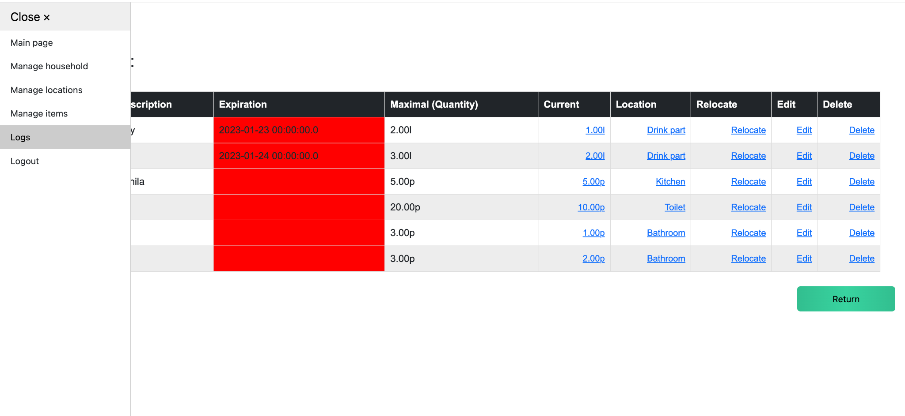
Log

Slide 18
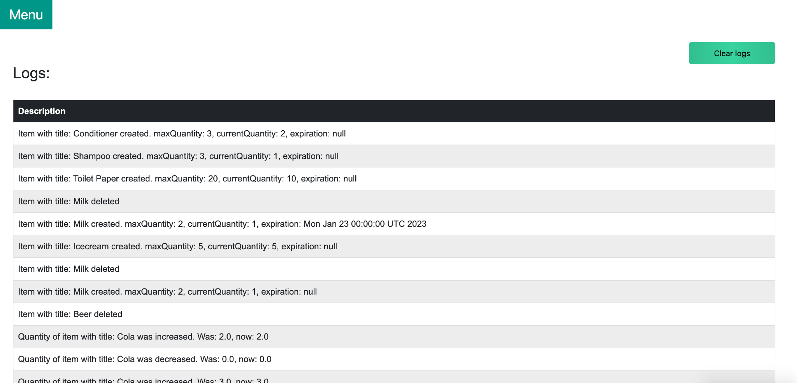
Log
Here you can see the history of all the changes with Items
👈 You can clear all logs

Slide 19
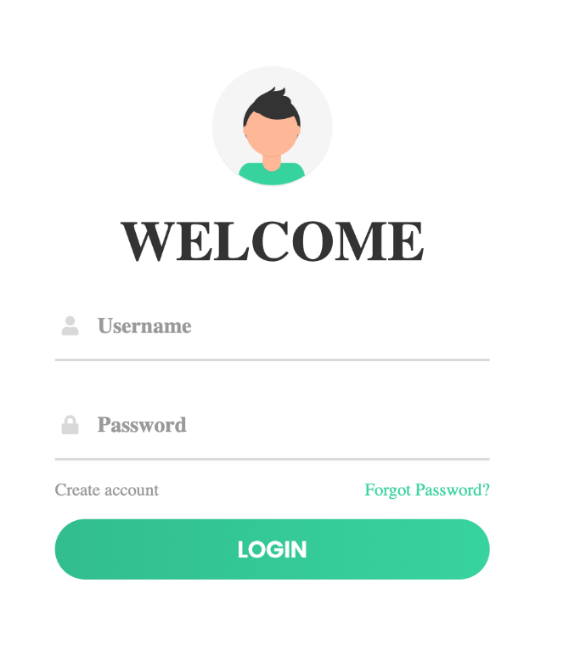
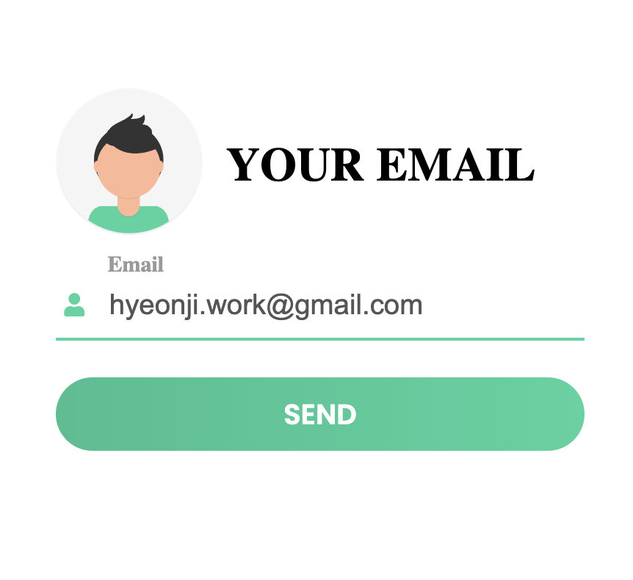
Password Recovery
When you forget your password
👈
The same email address from Sign up is required.
If the email address is correct, you will receive an email with a link for resetting your password.

Slide 20
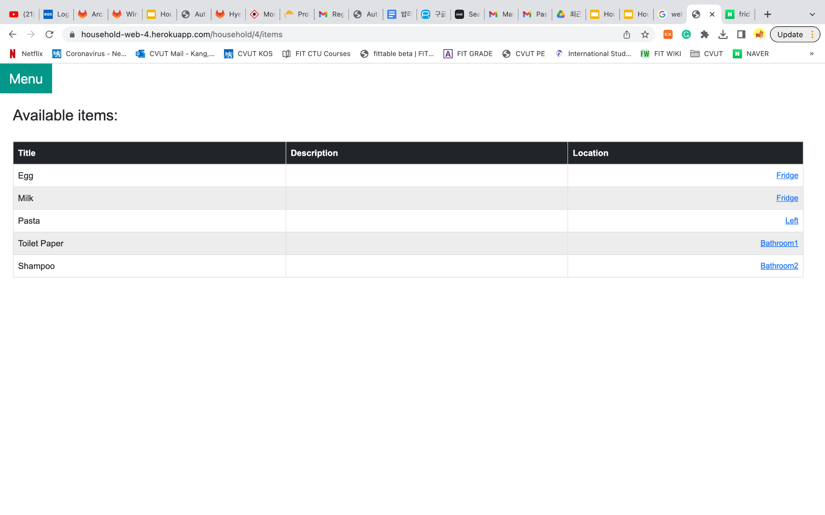
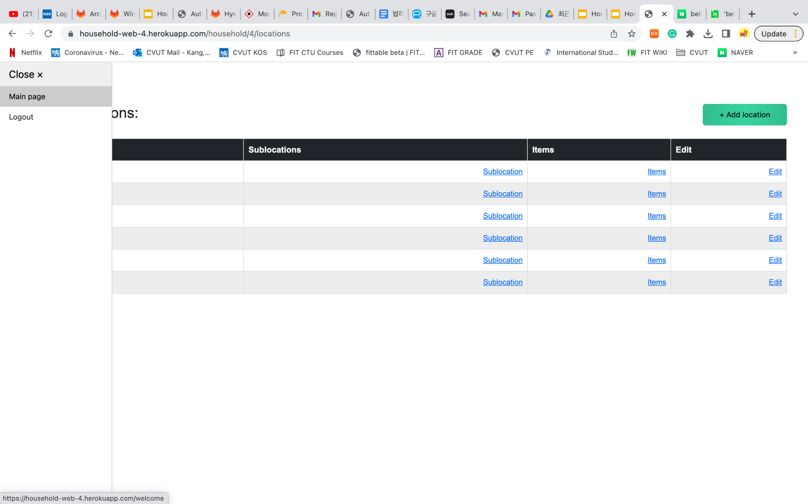
Last tip!
On the top left corner, you can extend the bar, and always go back to the Main page or Logout!

